Slide 1
DPCM
A Control-Plane Perspective on Reducing Data Access Latency in Mobile Networks
Yuanjie Li¹, Zengwen Yuan¹, Chunyi Peng²

Slide 2

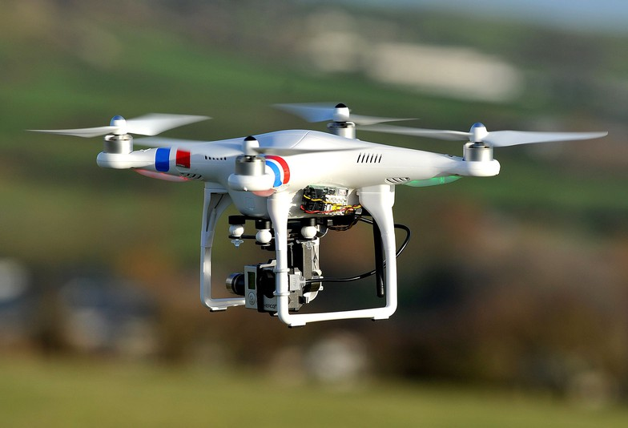

We want Always-on, Low-Latency Network

Slide 3
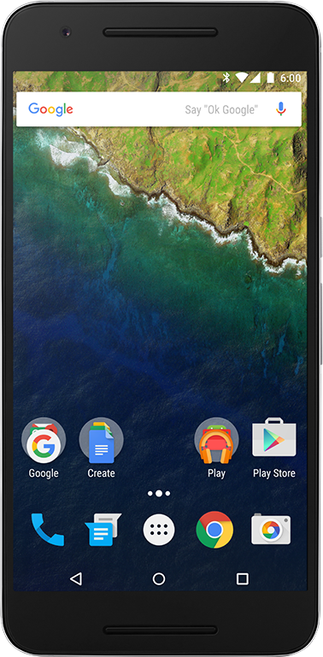

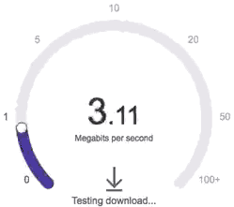
We want Always-on, Low-Latency Network
Better Wireless with lower radio latency
App/Transport-layer Optimization
to reduce E2E latency

Slide 4

We want Always-on, Low-Latency Network
But…
Why is it still slow?
www.youtube.com
Loading…
Besides the wireless and apps, the control plane is also critical for data latency

Slide 5
A New Perspective of Data Latency
Revisit Control-Plane Functions
This work:

Slide 6

How Control Plane Affects Data Latency
Establish data session to the Internet
Migrate the session as the device moves
Mobile Network (4G LTE)
www.youtube.com
www.youtube.com
Loading…
Loading…
The data access is blocked before the control-plane operations are completed.

Slide 7
Today: Control Plane is Slow in 4G LTE
Long latency for every session establishment/migration
Trainset failures further prolong the control-plane latency
Frequent impact on data latency:
Every 106.9s in static scenario. Every 70.0s in walking

Slide 8
Why: Sequential Control-Plane Operations
Mobile Network (4G LTE)
www.youtube.com
Loading…

Slide 9
Why: Sequential Control-Plane Operations
New Location
Old Location
Control-plane
Data-plane
Radio conn. setup
Session state migration
(QoS, billing, security, …)
Authentication
Extra data
access latency
Routing path update
User profile location update
UL/DL data services available
Example: session migration
as the device moves

Slide 10
Sequential Operation is More than Necessary
Control-plane
Data-plane
Radio conn. setup
Session state migration
(QoS, billing, security, …)
Authentication
Routing path update
User profile location update
Non-mandatory procedures block data
Parallelizable procedures are forced to run sequentially
Failures block the entire operations
UL/DL data services available

Slide 11
DPCM: Control-Plane Acceleration
for Low-Latency Data Access
Relax the strict ordering of sequential control-plane actions
Challenge 1: How to retain the control/data-plane correctness?
Challenge 2: How to achieve these accelerations efficiently?
Pipeline control procedures with data
Parallelize multiple control procedures
Bypass the slow control procedures
Non-mandatory procedures block data
Parallelizable procedures are forced to run sequentially
Failures block the entire operations

Slide 12
DPCM: Control-Plane Acceleration
for Low-Latency Data Access
Relax the strict ordering of sequential control-plane actions
Acceleration as distributed state management
Challenge 1: How to retain the control/data-plane correctness?
Challenge 2: How to achieve these accelerations efficiently?
Utilize the control state replicas on device and network
Pipeline control procedures with data
Parallelize multiple control procedures
Bypass the slow control procedures

Slide 13
Acceleration as Distributed State Management
Control-plane
Data-plane
Radio conn. setup
Location
Session state migration
(QoS, billing, security, …)
QoS
Billing
ACL
IP
Location
Security
Security
Authentication
Routing path update
QoS
Billing
ACL
IP
Location
Security
User profile location update
Location
UL/DL data services available

Slide 14
State-of-the-Art (4G LTE): Globally Sequential State Operations
Acceleration as Distributed State Management
Control-plane
Data-plane
Location
Location
Location
Location
Location
Location
ACL
ACL
ACL
ACL
ACL
Billing
Billing
Billing
Billing
Billing
Billing
Billing
IP
IP
IP
IP
IP
Security
Security
Security
Security
Security
Security
QoS
QoS
QoS
QoS
QoS
QoS
QoS
Acceleration = Equivalent, but faster state operations
UL/DL data services available

Slide 15
LTE: Primary copy only (controller)
DPCM: All replicas are utilized
Acceleration with State Replicas
Control-plane
Data-plane
Location
Location
Location
Location
Location
ACL
ACL
ACL
ACL
ACL
Device-side replica:
Almost “always-on”
Billing
Billing
Billing
Billing
Billing
Billing
Billing
IP
IP
IP
IP
IP
Security
Security
Security
Security
Security
Security
QoS
QoS
QoS
QoS
QoS
QoS
QoS
Network-side replicas:
More than controller

Slide 16
Acceleration with State Replicas:
Bypass the Slow Control Procedures
Bypass
Pipeline
Parallelize
Control-plane
Data-plane
Location
Location
Location
Location
Location
Location
ACL
ACL
ACL
ACL
ACL
Billing
Billing
Billing
Billing
Billing
Billing
IP
IP
IP
IP
Security
Security
Security
Security
Security
Security
QoS
QoS
QoS
QoS
QoS
QoS
Shorter side-path with
device-side state replica

Slide 17
Acceleration with State Replicas:
Pipeline the Data and Control
Bypass
Pipeline
Parallelize
Control-plane
Data-plane
Location
Location
Location
Location
Location
Location
Location
ACL
ACL
ACL
ACL
ACL
Billing
Billing
Billing
Billing
Billing
Billing
Billing
IP
IP
IP
IP
IP
Security
Security
Security
Security
Security
Security
QoS
QoS
QoS
QoS
QoS
QoS
QoS
UL/DL data services available
In-band signaling installs states
earlier on the data path
IP Data
IP Data

Slide 18
Acceleration with State Replicas:
Parallelize the Control Procedures
Bypass
Pipeline
Parallelize
Control-plane
Data-plane
Location
Location
Location
Location
Location
Location
Location
Location
Location
Location
ACL
ACL
ACL
ACL
ACL
ACL
ACL
ACL
Billing
Billing
Billing
Billing
Billing
Billing
Billing
Billing
Billing
Billing
Billing
Billing
IP
IP
IP
IP
IP
IP
IP
IP
Security
Security
Security
Security
Security
Security
Security
Security
Security
QoS
QoS
QoS
QoS
QoS
QoS
QoS
QoS
QoS
QoS
QoS
QoS
Concurrent operations via replicas
Concurrent operations via replicas
Mobility Controller has the final say

Slide 19
Acceleration with State Replicas:
Tolerating the Transient Failures
Bypass
Pipeline
Parallelize
Control-plane
Data-plane
Location
Location
Location
Location
Location
Location
Location
ACL
ACL
ACL
ACL
ACL
Billing
Billing
Billing
Billing
Billing
Billing
Billing
Billing
IP
IP
IP
IP
IP
Security
Security
Security
Security
Security
Security
QoS
QoS
QoS
QoS
QoS
QoS
QoS
QoS
More information in the paper:
External radio failures
Internal control/data-plane failures
Replicas tolerates failures and prevents control-plane blocking

Slide 20
Acceleration with State Replicas:
Handling the Concurrent State Conflicts
Bypass
Pipeline
Parallelize
Control-plane
Data-plane
Location
Location
Location
Location
Location
ACL
ACL
ACL
ACL
Billing
Billing
Billing
Billing
Billing
Billing
IP
IP
IP
IP
Security
Security
Security
Security
Security
QoS
QoS
QoS
QoS
QoS
QoS
State conflicts are infrequent:
1.3% “writes” in operational LTEs

Slide 21


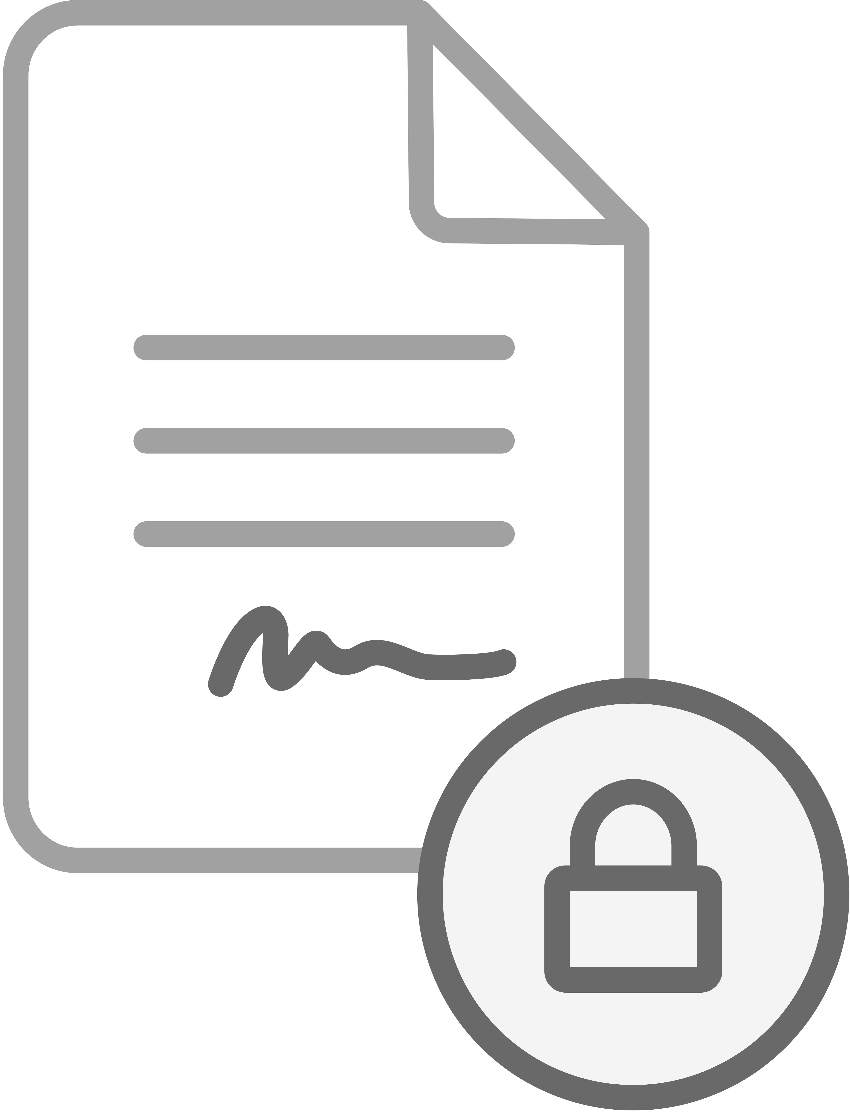
Acceleration with State Replicas:
Handling the Concurrent State Conflicts
Bypass
Pipeline
Parallelize
Control-plane
Data-plane
Location
Mismatched Fingerprint! Rollback to 4G LTE
ACL
ACL
Billing
Billing
IP
IP
Security
Security
Security
Higher QoS
QoS
Device-side Concurrent update:
Disallowed, detection via fingerprint
IP Data

Slide 22
Acceleration with State Replicas:
Handling the Concurrent State Conflicts
Bypass
Pipeline
Parallelize
Control-plane
Data-plane
Location
Location
Location
Location
Location
Location
ACL
ACL
ACL
ACL
ACL
ACL
Billing
Billing
Billing
Billing
Billing
Billing
Billing
Billing
Billing
IP
IP
IP
IP
IP
IP
Security
Security
Security
Security
Security
Security
Security
QoS
QoS
QoS
QoS
QoS
QoS
QoS
QoS
QoS
Network-side Concurrent update:
Mobility Controller has the final say

Slide 23

DPCM Implementation
A software extension of OpenAirInterface (OAI)
Incremental deployability & backward compatibility
Network-side virtualization + device-side daemon

Slide 24
Evaluation
Testbed configured to approximate real networks
  Network: 7 VMs running OAI+DPCM
  Device: OAI’s built-in emulator
  Parameters/latencies/failures from user study logs
Compare with 4G LTE in three dimensions
  Control-plane latency reduction
  Benefits for mobile applications
  System overhead

Slide 25
Control-Plane Latency Reduction
More latency reduction in the mobile scenario
Control plane latency dominates if radio latency greatly reduces
4G LTE
5G New Radio Projection
(Assuming 1ms radio latency)
5.8x
88.9x
2.1x
13.4x
More reductions in failure handling: up to 11s (11.5x in 4G, 317.8x in 5G)

Slide 26
Benefits for the Mobile Applications
Apps experience longer delay than data access latency, due to imperfect adaptations
2.1x
1.7x
2.1x
3.7x
Without failures
With failures

Slide 27
Acceptable System Overhead
Overhead | Network Node | Mobile Device
Signaling | 56 bytes/msg | 312 bytes/msg
CPU | 1.3% | 0.1%
Memory | 53.9MB | 3.5MB

Slide 28
Remark: Data Latency Sequential Control
CAP Theorem for Mobile Network:
Impossible for any design to guarantee sequential Consistency, Availability, and control-plane Partition (fault) tolerance simultaneously.
Y.L. et.al, “CAP on Mobility Control for 4G LTE Networks”, HotWireless’16

Slide 29
Conclusion
Control plane operations are vital to data latency
DPCM: Control-plane acceleration via state replicas
Rethink latency VS. sequentitality in 4G/5G design

Slide 30
For more details, please visit http://metro.cs.ucla.edu/dpcm.html
Yuanjie Li¹, Zengwen Yuan¹, Chunyi Peng²
¹University of California, Los Angeles
²Purdue University
Notes:
Thanks. I am happy to take questions.

Slide 31
Backup

Slide 32
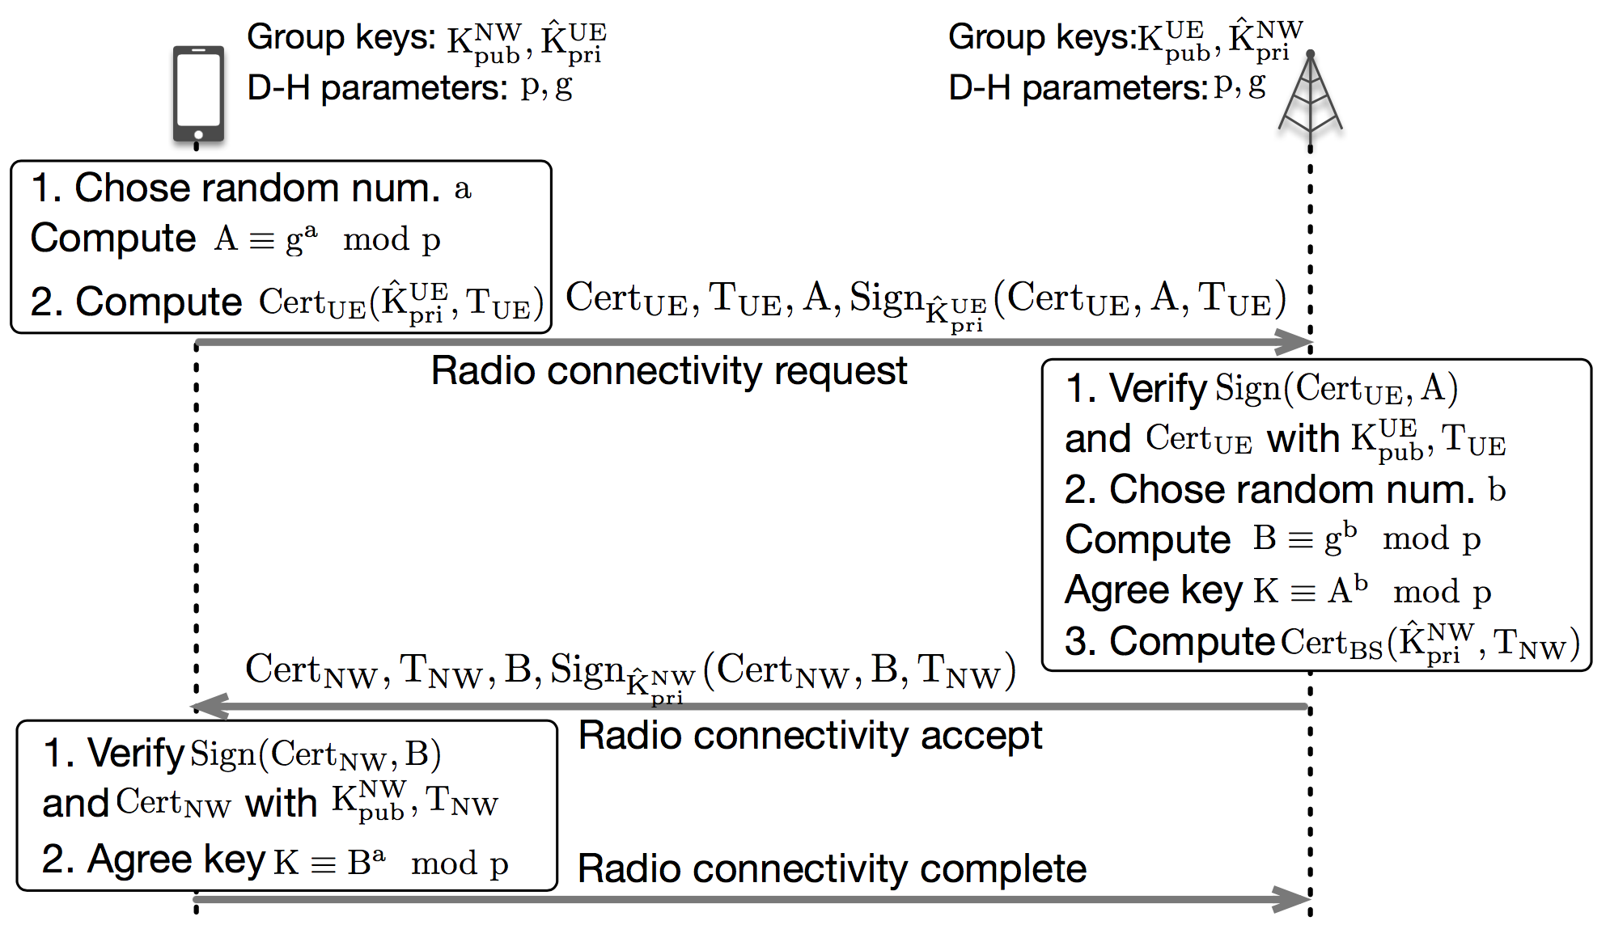
Retaining Same Security Level as 4G LTE
Security delegation: Local authentication & key agreement
More information in the paper: MitM attack defense, DoS defense, local device attacks defense, …

Slide 33
Device-side Latency Inference for Each Control-Plane Procedure
Correlate control-plane procedures with
device-side observations using standards

