Slide 1


cniCloud
Querying the Cellular Network Information at Scale
Wenguang Huang¹, Chang Zhou¹, Yuanjie Li²,
Xinbing Wang¹, Songwu Lu², Luoyi Fu¹
¹Shanghai Jiao Tong University
²University of California, Los Angeles

Slide 2


Mobile Internet Anywhere, Anytime
In-building
Outdoor
Walking
Driving
2
2

Slide 3



Ubiquitous Access via Cellular Network
…
Internet
Cellular Core
3

Slide 4

Ubiquitous Access via Cellular Network
Session Management
Mobility Management
Internet
Cellular Core
Radio Resource Control
SW
HW
Link Layer
Physical Layer
4
4

Slide 5







Developers & Researchers Need Insights for Cellular
Comparing the operators
Quantifying cellular behaviors
Home
Campus
Sprint
Sprint
“iCellular: Device-Customized Cellular Network Access
on Commodity Smartphones”, NSDI’16

Slide 6
It is not Easy to Understand Cellular Network
Issue 1: Cellular as a Black Box
? ? ?
Session Management
Issue 2: Analysis at scale
Mobility Management
Internet
? ? ?
Cellular Core
Radio Resource Control
SW
HW
Link Layer
?
Physical Layer
?
?
?
6
6

Slide 7
Can Researchers and Developers Analyze the “Black-box” Cellular Network at Scale?

Slide 8


cniCloud: Analyzing the Cellular Network at Scale
In-device access to fine-grained info
Issue 1: Cellular as a Black Box
? ? ?
Session Management
Scale out to heterogeneous phones
Issue 2: Analysis at scale
Mobility Management
Internet
? ? ?
Cellular Core
Radio Resource Control
SW
HW
Link Layer
?
Physical Layer
?
?
?
8
8

Slide 9
Outline
Motivation
Design
Evaluation
Ongoing work
Conclusion

Slide 10
Design Goals
Sharing and crowdsourcing fine-grained cellular info
Efficient and Scalable Information Management
cniCloud
User-friendly structured query (SQL-like)

Slide 11


System overview
Fine-grained logging & sharing
…
cniCloud
Efficient Data Management
Structured Query
SQL Query
SQL Response

Slide 12
Log Collection
How to share & crowdsourcing fine-grained cellular info?

Slide 13
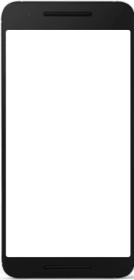




Sharing the Cellular Logs from Massive Phones
Storage Servers
Nexus-6
Sprint
20171018_LA_
Nexus-6_Sprint.log
20171018_LA_
VS985_AT&T.log
20171018_LA_
G900T_Verizon.log
20171018_LA_
LS660_T-Mobile.log
Samsung
AT&T
Log gathering
Samsung
Verizon
Nexus-6
Sprint
Samsung
AT&T
Samsung
Verizon
LG LS660
T-Mobile
LG LS660
T-Mobile
…
Classification

Slide 14
Challenge: In-device Access to Fined-grained Info
…
Android APIs
Software
Radio Interface Layer
Hardware
Coarse-grained
cellular info
SM
MM
RRC
Link layer
PHY

Slide 15

Solution: Side-Channel Across SW-HW Boundary
Parsers
…
Proxy
via USB
Raw cellular
messages
Android APIs
Software
/dev/diag
Radio Interface Layer
Hardware
Coarse-grained
cellular info
SM
MM
RRC
Link layer
PHY
More details: http://www.mobileinsight.net

Slide 16
Data Management
How to efficiently manage massive cellular info?

Slide 17

Challenge: Big Cellular Data from Massive Phones
Server Cluster
SQL Query
SQL Query
SQL Responses
SQL Response
Raw Logs
60s per query!
Scalability:
Every query must traverse ~10M of of cellular messages
Efficiency:
Disk I/O is the major bottleneck of query latency

Slide 18



Solution: Scalable, In-Memory Distributed Database
Server Cluster
SQL Query
SQL Response
Raw Logs
Scalability:
Every query must traverse ~10M of of cellular messages
Efficiency:
Disk I/O is the major bottleneck of query latency

Slide 19
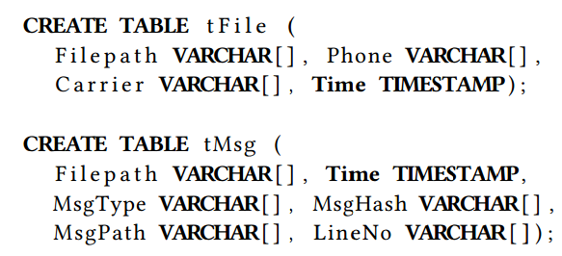



Solution: Scalable, In-Memory Distributed Database
Server Cluster
SQL Query
SQL Response
Raw Logs
Index-based Metadata
40x data volume reduction
Scalability:
Every query must traverse GBs/TBs of cellular data
Efficiency:
Disk I/O is the major bottleneck of query latency

Slide 20
Solution: Scalable, In-Memory Distributed Database
Server Cluster
In-memory Table Cache
In-memory Computation
SQL Query
SQL Response
Raw Logs
Index-based Metadata
40x data volume reduction
Scalability:
Every query must traverse GBs/TBs of cellular data
In-memory Processing:
Mitigate the disk I/O
Efficiency:
Disk I/O is the major bottleneck of query latency

Slide 21
Querying Interface
How to support the easy-to-use query?

Slide 22
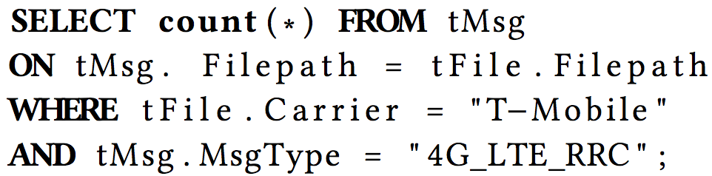
Example of Queries
Comparing the operators
Quantifying cellular behaviors
Home
Campus
Sprint
Sprint

Slide 23
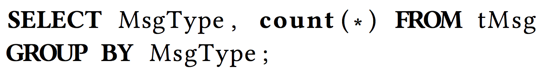
Example of Queries
Comparing the operators
Quantifying cellular behaviors
Home
Campus
Sprint
Sprint

Slide 24
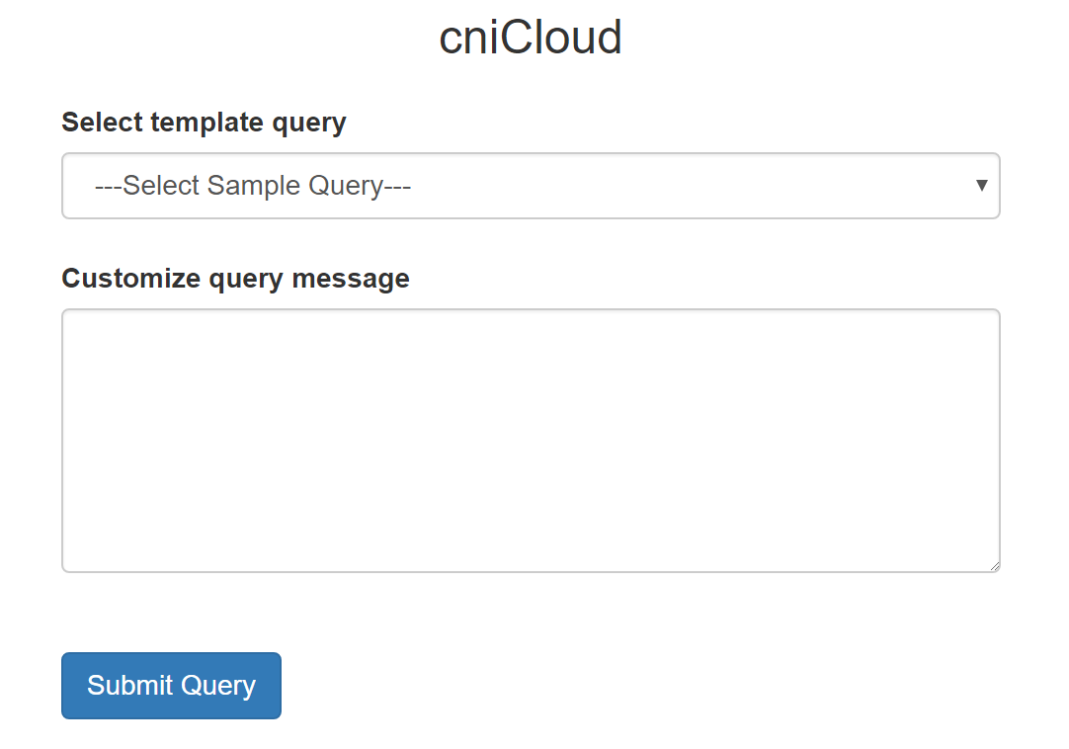
Frontend Query Interface
Design
Server Cluster
Web-based interface
Spark thrift server
(Java JDBC interface)
Translate
into spark
command
Check
legality
Data
Management
Section
SQL Query
SQL grammar support
SQL Response
Return
result
Return
result

Slide 25

Demo: Characterizing the Cellular Patterns
Design
http://www.mobileinsight.net/cnicloud.html

Slide 26
Demo: Compare Cellular Operators
Design
http://www.mobileinsight.net/cnicloud.html

Slide 27
Evaluation
Efficiency, scalability and overhead

Slide 28
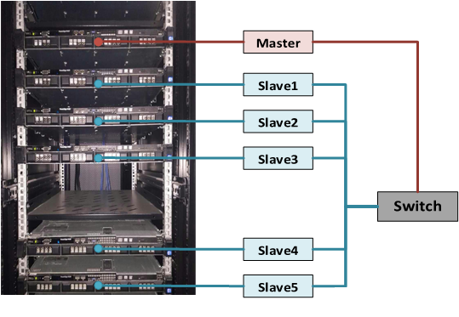
Evaluation - Setup
Evaluation data:
Cluster environment:
Dataset | Number
Size | 19,619,665 4G/3G messages
 | 17,873 log files
When | 19-month period (07/31/2015 ~ 02/28/2017)
Where | 23 phones
 | 7 Android models
 | 4 U.S. carriers, 2 Chinese carriers, 2 European carriers, 2 MVNOs
Hardware | Resource
Number of nodes | 1 master, 5 workers
CPU per node | 1 CPU, 4 cores
Memory per node | 32 GB RAM
Storage per node | 4 TB HDD
Network per node | 1Gbps
Network Topology | Star-Topology

Slide 29
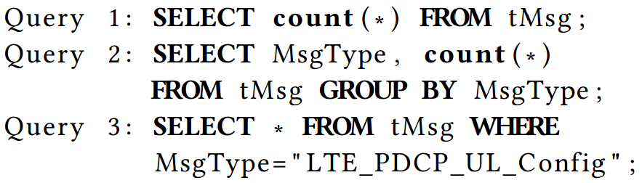
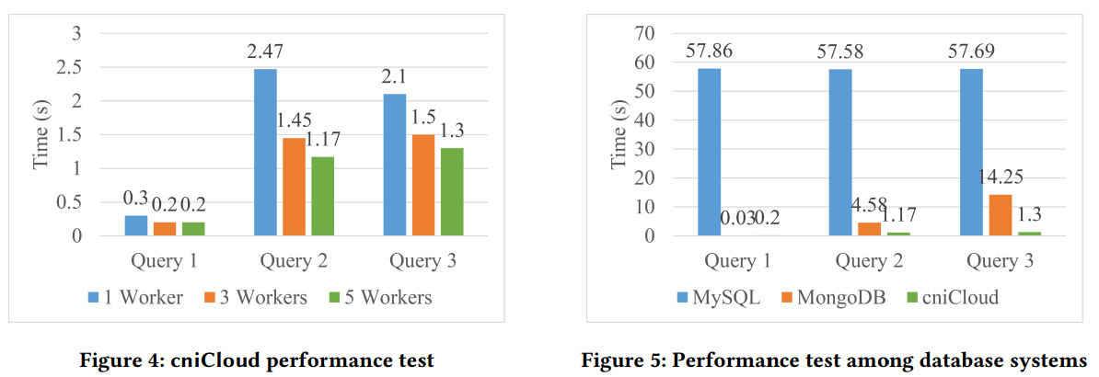
Evaluation – Efficiency
Workload: Query 3 > Query 2 > Query 1
40x times query acceleration

Slide 30
Evaluation – Scalability
Workload: Query 3 > Query 2 > Query 1
More workers -> Better performance

Slide 31
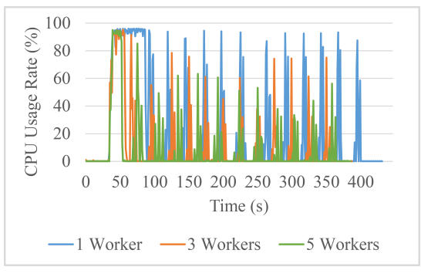
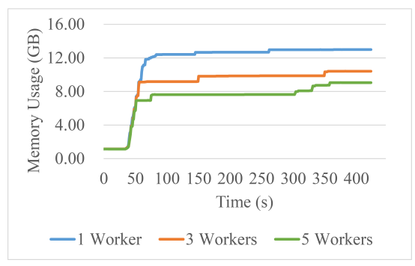
Evaluation - Overhead
CPU usage per node
Memory usage per node
More workers -> Shorter duration of full-utilization
More workers -> Less memory/node

Slide 32
Ongoing work
Diverse query patterns: Parameters, transactions, cross-layer queries, …
Mining cellular info: From data query to information
Infrastructure-free information base: Peer-to-peer data and knowledge sharing between mobile devices

Slide 33
Summary
Design
Understanding the “black-box” cellular information at scale is
beneficial to researchers and developers
cniCloud: Crowdsourcing makes large-scale fined-grained
cellular network information analysis possible.
Future: From data base to knowledge base.

Slide 34
THANK YOU!
http://www.mobileinsight.net/cnicloud.html
Wenguang Huang¹, Chang Zhou¹, Yuanjie Li², Xinbing Wang¹, Songwu Lu², Luoyi Fu¹
¹Shanghai Jiao Tong University
²University of California, Los Angeles

